Slide 1
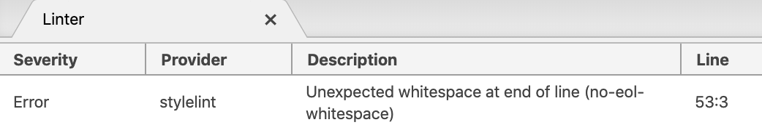
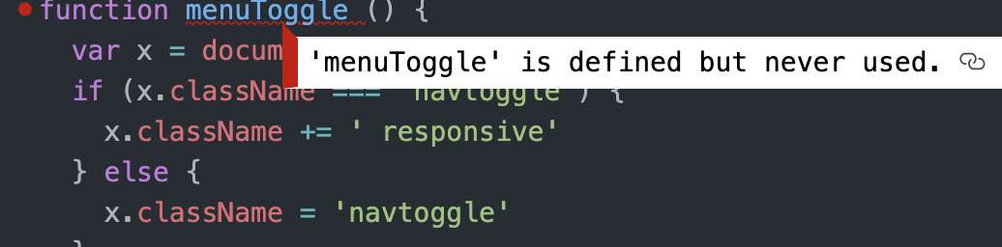
2.5: Code Quality & Cross-Browser Testing
Linters:
HTML : W3C Validator, plus the W3C Atom plugin
CSS Linter : linter-stylelint Atom plugin
JS Linter : Linter-js-standard Atom plugin
Errors :
The errors I corrected were primarily spacing issues. My comment/note spacing was inconsistent across the board with too many or too few spaces. A lot of these errors arose after using the beautify plugin for formatting. I have found beautify doesn’t help with comments and spacing as per the ‘linters’ suggested formats.
Color Check Accessibility:
I need to recolor my website and review my entire palette choices based on the results from https://accessible-colors.com/
My palette did not take into consideration accessibility factors. However, I have now learned what to consider in the future projects.
I was able to change my navigation bar to pass the AA by changing my white font to dark brown.
Cross-Browser Testing:
The simplicity of the site at this moment did not present any browser issues. As I make my portfolio site more complex I will continue to check on this.
Follow-ups:
I need to review and learn more about the linter ‘warnings’ and what they may impact. I will review my formatting and CSS code to make sure I am developing code that is easy to follow and not too complex because it doesn’t need to be at this stage.
I also need to check-in on my java error and learn more about the implications of this error.

Slide 2
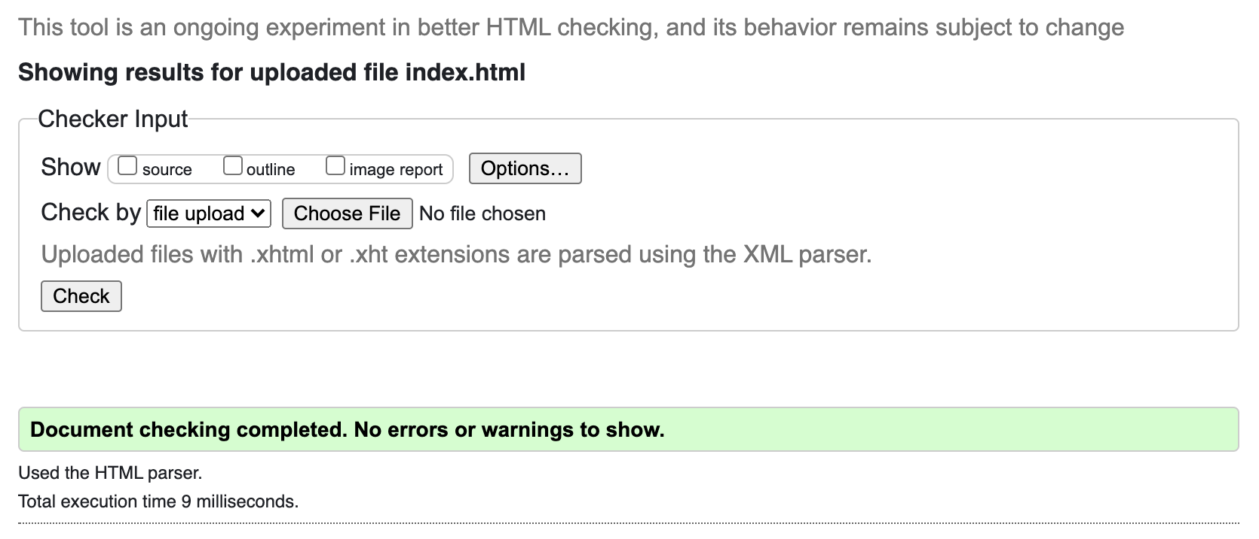
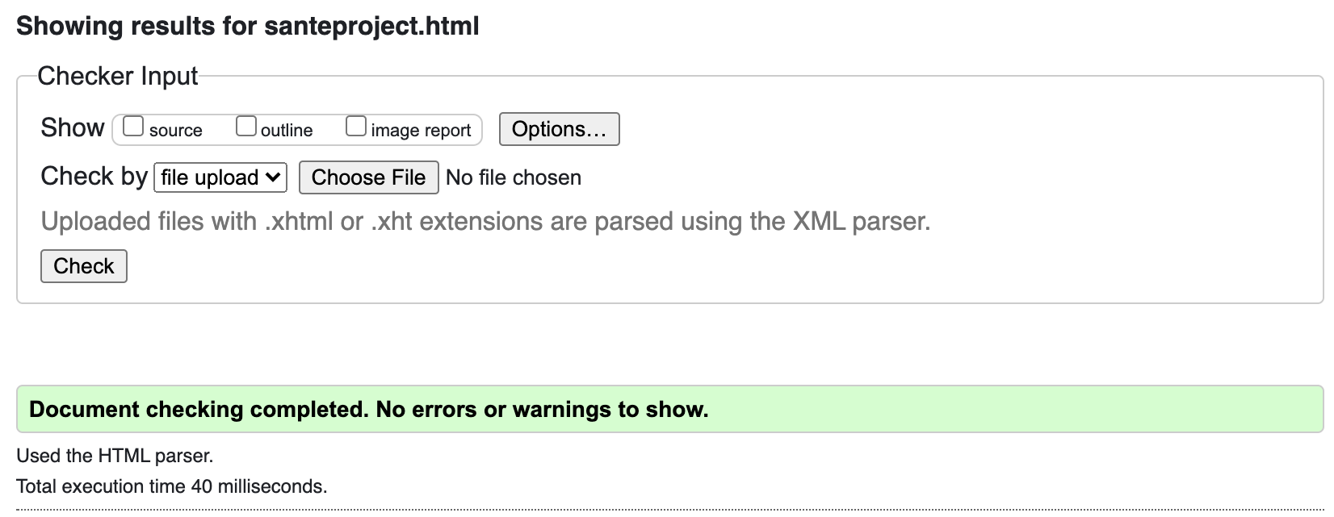
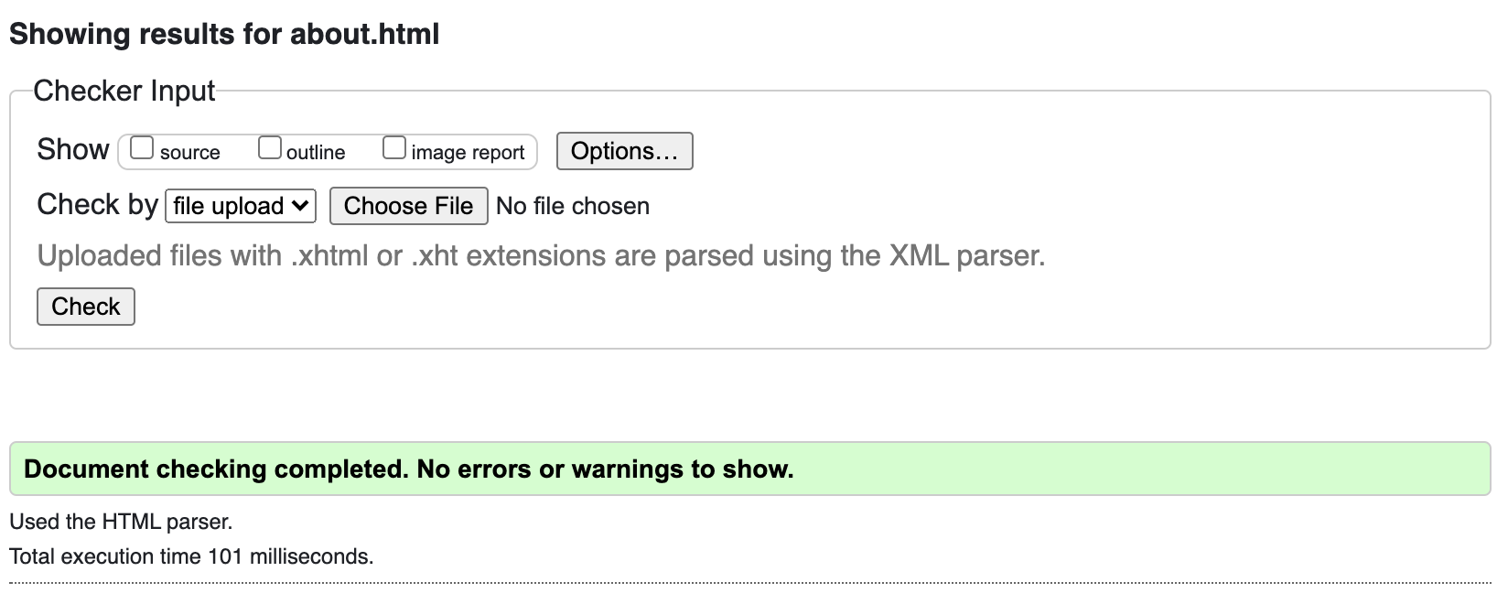
W3C validator check

